Slide 1
Oral Communication
Lecture 3
By
Noreen Shah

Slide 2
Definition
Oral Communication, also known as verbal communication, is the interchange of verbal messages between the sender and receiver. It is more immediate than written communication. It is also more natural and informal.

Slide 3
Need for Learning Oral Communication Skills
To help problem solving
To resolve conflicts
To influence people to work together
To persuade others to be involved in organizational goals
To be assertive without being aggressive
To develop listening skills
To be an effective negotiator
To make a proposal

Slide 4
Objectives of Oral Communication In Business
It is known that a manager’s maximum time is devoted to oral communication. He is engaged in meetings, discussions, negotiations, seminars, presentations, interviews, peer conversations, subordinate instructions and telephonic conversations.

Slide 5
Choice of Form of Communication
A Manager’s choice between the oral and written communication is guided by considering the suitability of oral or written form for the purpose and nature of the subject of communication.

Slide 6
Principles of successful oral Communication
Oral communication should, first of all, have the rhythm and tone of living voice.
The pitch of our voice should take into consideration the distance between the listener and you.
The tone should be marked by the accent of sincerity and confidence.
In oral communication the manner of speaking is, at many times, more important than words, which communicate only 7% of the total message.

Slide 7
Nature of The Spoken Words
Unlike the printed words (of the written message), the spoken words (in oral communication) is ephemeral (short lived). This is an inherent limitation of speech. To overcome this limitation there should be a due correlation between the pace of speaking and the rate of listening.

Slide 8
What is Fluency?
Fluency usually means ease as a condition of speaking but a fluent speaker is one who is heard with ease. The listener does not have to strain his mind to receive, register, and interpret the heard message.

Slide 9
Characteristics of Effective Oral Communication
The communicator should follow the following:
Consider the objectives
Think about the interest level of the receiver
Be sincere
Use simple language, familiar words
Be brief and precise

Slide 10
Characteristics of Effective Oral Communication
Avoid vagueness and generalities
Give full facts
Assume nothing
Use polite words and tone
Cut out insulting message
Say something interesting and pleasing to the recipient
Allow time to respond

Slide 11
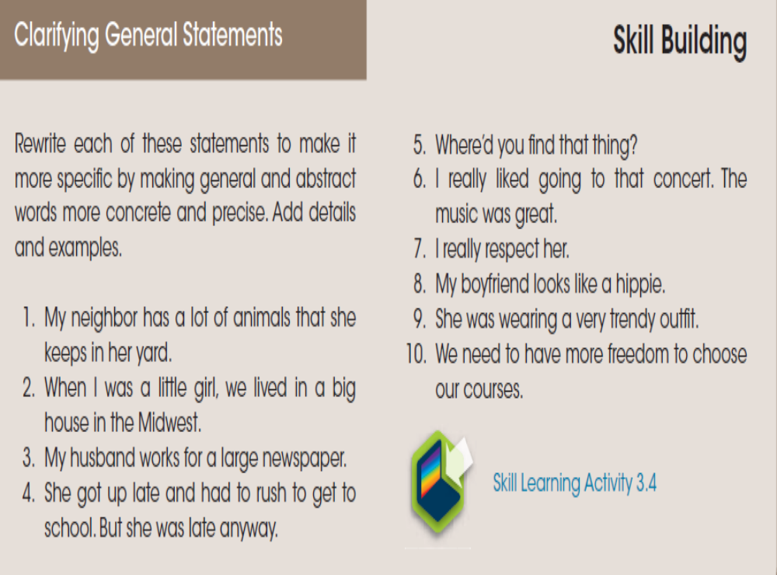

Slide 12
Barriers to Effective Oral Communication
The foremost barrier to oral communication is poor listening. Listening is a psychological act affected by several factors such as status, halo effect, complexes, closed mind, poor retention, abstracting, slant, premature evaluation, hurried conclusions, and cognitive dissonance.

Slide 13
Status
In organizations, there are formal and informal status levels that affect the effectiveness of face to face oral communication. The fear of superior status prevents free upward flow of information. It conditions free and fair exchange of ideas.

Slide 14
Halo
The awe in which the speaker is held by the listener conditions the act of true listening. Under the halo effect in business, buyers tend to go by the trusted sellers view of a thing, rather than by their own judgment of the product quality.

Slide 15
Complexes
A lack of confidence or sense of superiority may prevent proper oral interaction between persons differently positioned. Sometimes one suffers from a sense of being inferior and, therefore, face problems to take initiative or involve himself / herself in conversations / dialogue or any other form of oral communication.often, these are misplaced notions of self-worth, but they do block oral communication.

Slide 16
Closed and All-Knowing Minds
Listening, to a large extent, depends on one’s curiosity to know things. Some persons believe that they know everything in a field or subject. Their minds refuse to receive things from other sources. The closed state of mind acts as a barrier to oral communication, which demands a readiness / willingness on the part of listener to enter into a dialogue.

Slide 17
Poor Retention
In dialogue, or two-way oral communication, the sequence of thought is essential for carrying on communication. To speak coherently one has to remember the sequence of ideas. The cues that signal the movement of thought of one set of ideas to another set of ideas must be retained by the listener to be able to grasp the full sense of the message discussed.

Slide 18
Premature Evaluation and Hurried Conclusions as Distortions
To listen patiently until the speaker completes his / her argument is necessary for correct interpretations for an oral message. The listener often distorts the real intended meaning of communication by either pre-judging the intention of the speaker, or inferring the final purpose and meaning of the message or giving a different twist to the argument according to his / her own assumptions, or just picking out a few shreds of information, perhaps from his / her point of interest.

Slide 19
Abstracting
Abstracting is mental process of evaluation of thought contents in terms of relative importance of ideas in the context of the total message. This is possible only on listening to the whole message, and not during the process of discussion.

Slide 20
Slant
It is usually attributed to the biased presentation of a matter by speaker.instead of straight talk, one speaks in an oblique manner that could be almost like telling a lie. When a matter is expressed with a particular slant, many other important aspects of the message are suppressed,left out or indirectly hinted.

Slide 21
Cognitive dissonance
At times the listener fails to accept or respond to assumptions underlying the new information communicated, as he/she is unprepared to change from the old basis of belief and knowledge. In such kind of discrepancy between the existing assumptions and the actual position communicated some listeners try to escape from the dissonance by interpreting, restructuring or mentally ignoring the oral interchange.

Slide 22
It may lead to several interpretations of a new message view.

Slide 23
Language barrier
The language of communication should be the medium shared by both speaker and listener.
Further, the listener should be familiar with the accent of the language in use.

Slide 24
What is Conversation Control
Conversation Control involves skills of listening and talking in a positive and meaningful way at an appropriate time. It includes:-
Techniques of changing the direction of conversation smoothly.
The ability to allow a discussion to develop along key issues in an uninterrupted way towards the desired end.

Slide 25
In business, the following situations require application of conversation control skills:-
How to negotiate
How to interview
How to sell or buy
How to participate in a meeting

Slide 26
How to disagree without being rude
How to protest without offending
How to compliment /praise
How to respond to personal criticism.

Slide 27
Summarizing as an integral skill of oral communication
Oral communication, especially conversation, it is necessary to convey to the other person that you understand his/her point. You may agree or disagree, but the first requirement of skillful communication is that the other person has the assurance that you have understood the facts as presented.

